Slide 1
Spring 2017 Info Session
January, 26th 2017, Berger Auditorium

Slide 2
What is Data Science?
Extract insights from data using…
Statistics
Machine Learning
Data Mining
Predictive Analytics
Data Visualization
Probability Models
…and more
https://en.wikipedia.org/wiki/Data_science
http://drewconway.com/zia/2013/3/26/the-data-science-venn-diagram

Slide 3
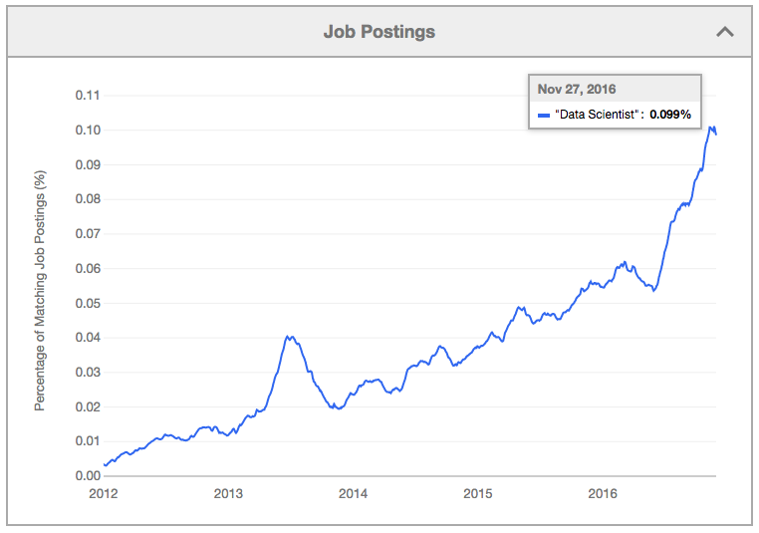
Why Be a Data Scientist?
https://www.indeed.com/jobtrends/q-%22Data-Scientist%22.html

Slide 4
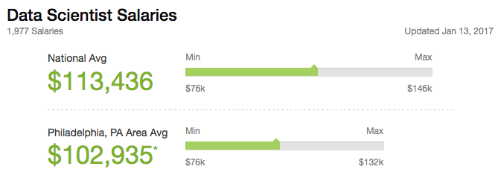
Why Be a Data Scientist?
https://www.glassdoor.com/Salaries/data-scientist-salary-SRCH_KO0,14.htm

Slide 5
What PDSG Does
Community Events Calendar
Resources Page
Workshops
Career Talks
Student Talks
Projects

Slide 6
Community Events Calendar
Types of events we list:
DataPhilly Meetups (meetup.com/DataPhilly)
Hackathons
Data-related Academic Seminars
Career Fairs
Company Info Sessions
Networking Events
Workshops
PDSG Events

Slide 7
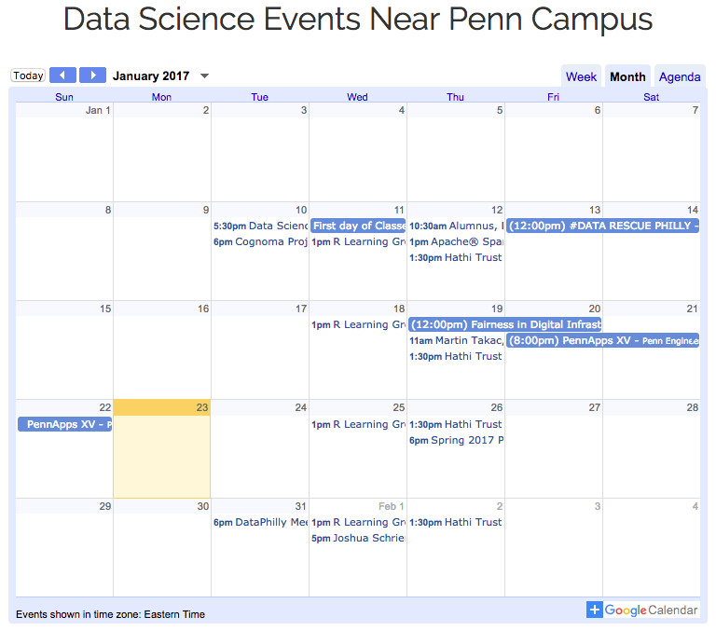
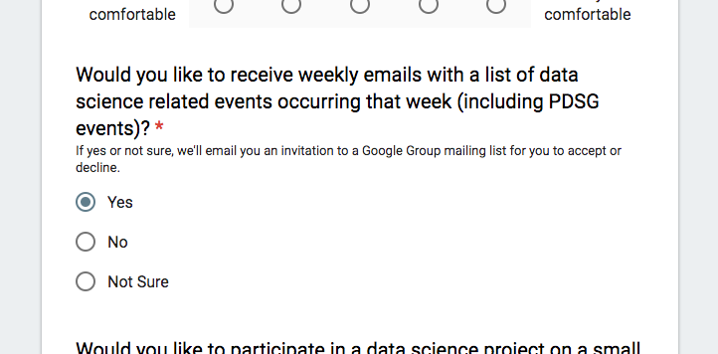
Community Events Calendar
Add to your
calendar
Get the weekly
newsletter
penndsg.com/events
penndsg.com/join
Other events? Send info to:
board@penndsg.com

Slide 8
What PDSG Does
Community Events Calendar
Resources Page
Workshops
Career Talks
Student Talks
Projects
penndsg.com/resources

Slide 9
What PDSG Does
Community Events Calendar
Resources Page
Workshops
Career Talks
Student Talks
Projects

Slide 10
Workshops
Hands-on practice with data science tools and techniques
Workshop currently in planning:
Predicting Titanic passenger outcomes
using Jupyter/iPython Notebook
Want to lead a workshop? Let us know: board@penndsg.com

Slide 11
What PDSG Does
Community Events Calendar
Resources Page
Workshops
Career Talks
Student Talks
Projects
We want to hear from…
Data Scientists
Data Engineers
Data Analysts
etc.
Send referrals to:
board@penndsg.com

Slide 12
What PDSG Does
Community Events Calendar
Resources Page
Workshops
Career Talks
Student Talks
Projects
We want to hear about your data-related…
Research
Internship Experience
Side Project
To volunteer, email
board@penndsg.com

Slide 13
What PDSG Does
Community Events Calendar
Resources Page
Workshops
Career Talks
Student Talks
Projects

Slide 14
Projects
Why do a project through PDSG?
Build your data science portfolio
Find like-minded people to work with you
Build something you can be proud of
Get help from other PDSG members by posting questions on Piazza
No really, why?

Slide 15
Project Prizes
If you want prizes like $50 Amazon gift cards,
here’s what to do:
Get a group of 2-4 people
Pick a data problem to explore
Tell us your team and project idea
Write a blog post style report on your project
Present your results in front of a panel of judges
Have one of the best projects
Collect gift cards (1 per team member, excluding board members)

Slide 16
Raffle Prizes
At the end of the semester, we’ll raffle off small prizes, like $5 Amazon or Starbucks gift cards. You get 1 raffle ticket for each:
Project report put up on the website
Student talk you give
Data professional referral who ends up giving a career talk
2 raffle tickets if you lead a workshop!

Slide 17
Kaggle Competitions
If you don’t know what kind of project to do, do a Kaggle competition
Clean datasets
Immediate model evaluation
Scripts shared by other competitors

Slide 18
Recommended Kaggle Competitions
Titanic: Machine Learning from Disaster
kaggle.com/c/titanic
Predict Titanic passenger outcome
Digit Recognizer
kaggle.com/c/digit-recognizer
Classify handwritten digits from famous MNIST data
Shelter Animal Outcomes
kaggle.com/c/shelter-animal-outcomes
Predict Austin Animal Center animal outcomes
TalkingData Mobile User Demographics
kaggle.com/c/talkingdata-mobile-user-demographics
Predict demographics characteristics from mobile phone data
Predicting Facebook Check-ins
kaggle.com/c/facebook-v-predicting-check-ins
Predict where people like to check in on Facebook based on fictitious data similar to data Facebook employees use

